Slide 2

C R Bhargavi
ww
Mtech Graduate from Bits Pilani
Blogger, Speaker
Microsoft certified trainer
Microsoft certified data scientist
Expertise in RPA(Uipath, pega), Azure

Slide 3
Agenda
1. Introduction to databricks
2. What is Azure data bricks
3. Why Azure Data bricks
4. Apache Spark
5. Workframes and clusters
6. Processing Big Data with Azure Databricks
7. Quering Dataframes
8. Demo

Slide 4
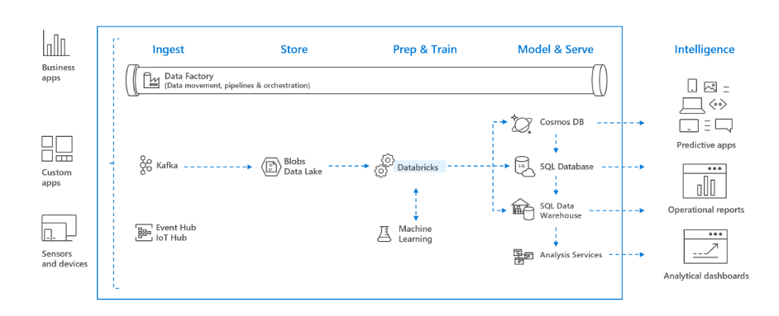
Introduction to Azure Databricks

Slide 5










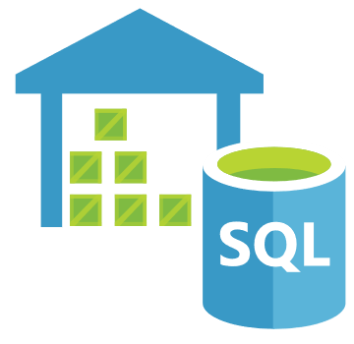
What is Azure Databricks ?
Apps
People
Azure Databricks
Analytics Platform
Deep Learning
ML
Data Science
Databricks Runtime
Streaming
Data Engineer
Power BI
Apache Spark
Business Analyst
Data Warehousing
Azure Blob
Storage
Azure Data
Lake Store
Azure SQL Data
Warehouse
Apache
Kafka
Hadoop
Storage

Slide 6
Why Azure Databricks
Apache Spark-based analytics platform:
Simplifies the provisioning and collaboration of Apache Spark-based analytical solutions dealing with batch and streaming data
Comprehensive Spark library support:
Support includes SQL, DataFrames, MLlib, Hyperspace and MSSparkUtil
Enterprise Security:
Utilizes the security capabilities of Azure
Integration with other Cloud Services:
Can integrate with a variety of Azure data platform services and Power BI

Slide 7
Workspace and clusters
Workspaces
Like folders, provide a way to organize a user’s code/notebooks, libraries, data
Each user has a separate directory
Hierarchical, allow subfolders
Allow collaboration with colleagues and access control
Clusters
Groups of nodes/machines where workloads are executed
All purpose or job-oriented
Multiple runtimes available
Allow provisioning via libraries
Multiple hardware configurations
Autoscaling, auto-termination

Slide 8
Processing Big Data with Azure Databricks
1. Ingestion
2. Store
4. Model & serve
3. Prep & train

Slide 9
Quering Dataframes
Read/write data from multiple data sources, in multiple formats
from pyspark.sql.functions import isnan, when, count, col
from pyspark.sql.types import *
dfTrips = spark.read.csv('dbfs:/FileStore/tables/nyc_taxi.csv', header=True, inferSchema=True)
dfCompanies = spark.read.csv('wasb://spark@account.blob.core.windows.net/data/taxi_companies.csv’)
dfTripsByCompany = dfTrips.join(dfCompanies, dfTrips.companyId == dfCompanies.id).groupBy(“branch").count()
udfConvert = udf(lambda z: c_to_f(z), DoubleType())
df.filter(col('temperature').isNotNull()) \
.withColumn("tempC", col("temperature")) \
.select(col("tempC"), c_to_f(col("tempC")).alias("tempF"))
df.count() - df.dropDuplicates().count()
df.select([count(when(col(c).isNull(), c)).alias(c) for c in df.columns])
df = df.fillna({'passengerCount':'1'}).dropna()
display(df.describe())
Aggregate, join, group, union data using DataFrames
Clean data,
explore and determine statistics

Slide 10
Demo

Slide 11






Platinum Partner
Gold Partner
Silver Partner

Slide 12

Further Quries?

